Slide 1

HNDIT2417
Mobile Application Development
Introduction to Android

Slide 2
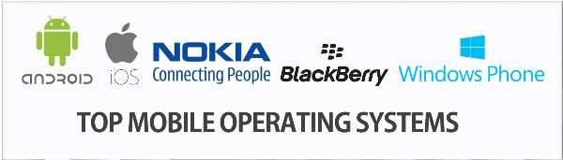
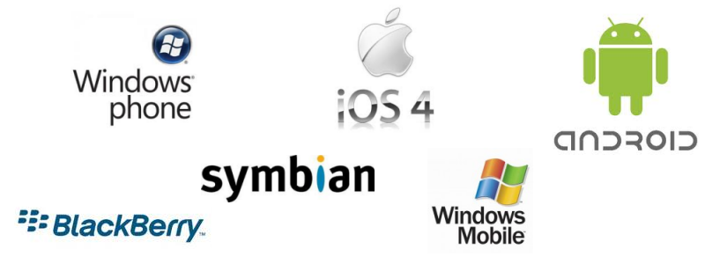

Slide 3
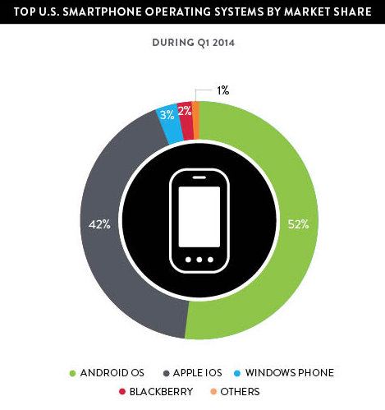
Introduction to Android
Popular mobile device OS: 52% of U.S. smartphone market
Developed by Open Handset Alliance, led by Google
Google claims 900,000 Android device activations

Slide 4
What is Android
Android is an operating system for mobile devices such as smartphones and tablet computers. It is developed by the Open Handset Alliance led by Google.
Android and Apple iOS, being the leading mobile operating system from first quarter of 2011

Slide 5
Android - Advantages
Android is largely supported by Google allowing you to use various services of Google.
Android is an open source and runs on mobile devices, tablets etc.
It is multitasking that means you can run many applications at the same time. For example, you can browse Facebook while listening the song.
The Android operating system is available on mobile phones from various manufacturers like Samsung, Motorola, HTC, Sony Ericsson etc.
Using Android phone, you can easily check e-mail from Gmail if your Gmail account is integrated with Google Services.
User can easily access a variety of settings quickly and easily.

Slide 6
Android - Disadvantages
Android requires continuous Internet connection if you are using Google services.
Android shows error & forces to close the large apps/games, which is very annoying.
It takes large amount of mobile data if a large number of background processes are running.
It increases the usage of RAM and decreases battery performance when many processes are running in the background.

Slide 7
Android versions
Android 1.0, 1.1 to 1.5 (Cupcake)
1.6 (Donut)
2.0/2.1 (Eclair)
2.2 (Froyo)
2.3 (Gingerbread),
3.0 (Honeycomb)
4.0 (Ice Cream Sandwich)
4.1-4.3 (Jelly Bean)
5.0 (Lollipop)
6.0 Marshmallow
7.0 Nougat
8.0 Oreo
9.0 Pie

Slide 8
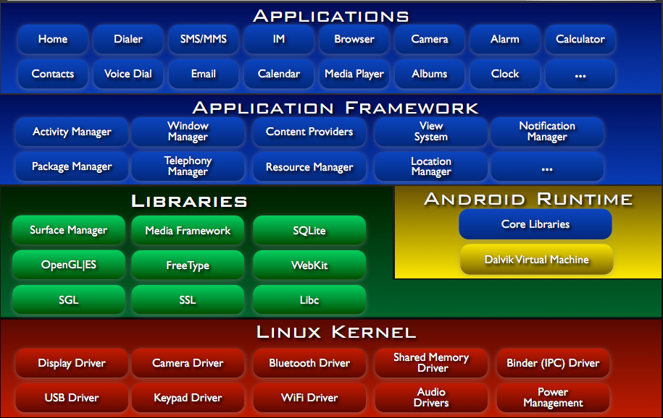
Android Architecture

Slide 9
Android Architecture
Applications (written in java, executing in Dalvik)
Framework services and libraries (written mostly in java)
  Applications and most framework code executes in a virtual machine
Native libraries, daemons and services (written in C or C++)
Linux kernel, which includes
  Drivers for hardware, networking, file system access and inter-process-communication
Kernel- Program that is the core of a computer's operating system, with complete control over everything.
Notes:
In multitasking computer operating systems, a daemon is a computer program that runs as a background process, rather than being under the direct control of an interactive user.

Slide 10
Android Runtime
Core libraries
Dalvik - a virtual machine that runs applications and code written in Java. A standard Java compiler turns source code (written as text files) into Byte code, then compiled into a .dex file that the Dalvik VM can read and use.
.dex – Davlink executable

Slide 11
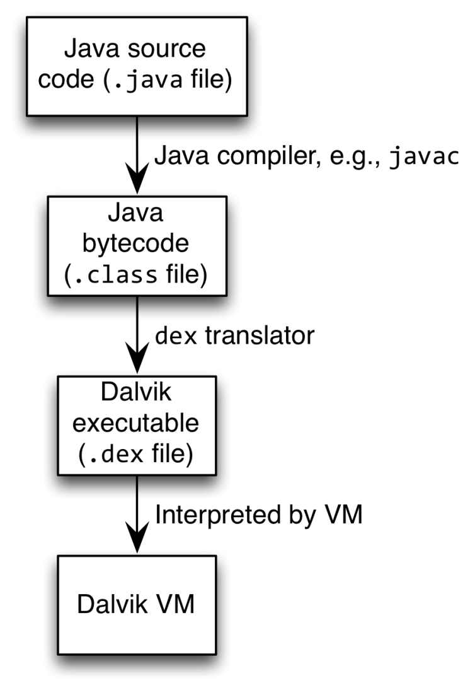
Android Highlight
Android apps execute on Dalvik VM
  Dalvik optimized for efficient execution
  Dalvik: register-based VM, unlike Oracle’s stack-based JVM
  Java .class bytecode translated to Dalvik EXecutable (DEX) bytecode, which Dalvik interprets

Slide 12
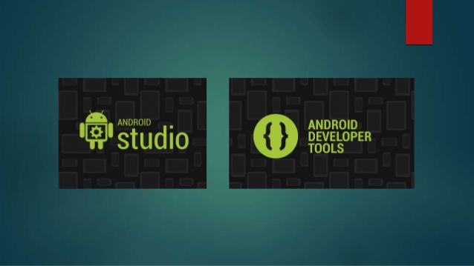
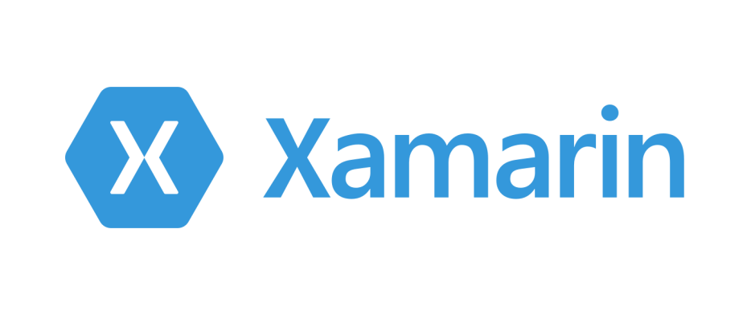
Development tools for Android
Eclipse as IDE with ADT
Android studio
Visual Studio With Xamarin

Slide 13
Android Studio
Android Studio is Android's official IDE.
It offer tools custom-tailored for Android developers, including rich code editing, debugging, testing, and profiling tools.
has more options for Android Development, making the process faster and more productive

Slide 14
Advantage
Android apps written in Java 5
  Actually, a Java dialect (Apache Harmony)
  Everything we’ve learned still holds

Slide 15
Android Studio
System requirements for Windows
  Java 7/8
  Microsoft® Windows® 7/8/10 (32- or 64-bit)
  3 GB RAM minimum, 8 GB RAM recommended; plus 1 GB for the Android Emulator
  2 GB of available disk space minimum,
  4 GB Recommended (500 MB for IDE + 1.5 GB for Android SDK and emulator system image)
  1280 x 800 minimum screen resolution

